Slide 1

Unix / Hadoop
Fundamentals

Slide 2
CONTENTS
Introduction to MapReduce
Mapper /Intermediate/ Reducer phases
Partitioners
Combiners

Slide 3
MapReduce
MapReduce is a programming model for writing applications that can process Big Data in parallel on multiple nodes. MapReduce provides analytical capabilities for analyzing huge volumes of complex data.
It can also be called a programming model in which we can process large datasets across computer clusters.
The MapReduce algorithm contains two important tasks, namely Map and Reduce.
Map takes a set of data and converts it into another set of data, where individual elements are broken down into tuples.

Slide 4
What is Big Data?
Big Data is a collection of large datasets that cannot be processed using traditional computing techniques.
For example, the volume of data Facebook or YouTube need require it to collect and manage on a daily basis, can fall under the category of Big Data.
However, Big Data is not only about scale and volume, it also involves one or more of the following aspects − Velocity, Variety, Volume, and Complexity.

Slide 5
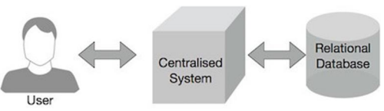
Why MapReduce?
Traditional Enterprise Systems normally have a centralized server to store and process data. The following illustration depicts a schematic view of a traditional enterprise system.
Traditional model is certainly not suitable to process huge volumes of scalable data and cannot be accommodated by standard database servers.
Moreover, the centralized system creates too much of a bottleneck while processing multiple files simultaneously.

Slide 6
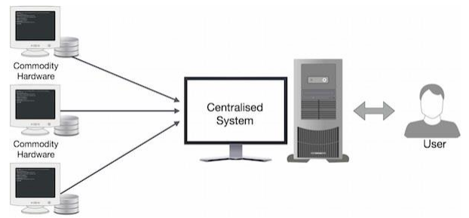
Google solved this bottleneck issue using an algorithm called MapReduce. MapReduce divides a task into small parts and assigns them to many computers.
Later, the results are collected at one place and integrated to form the result dataset.

Slide 7
How MapReduce Works?
The MapReduce algorithm contains two important tasks, namely Map and Reduce.
The Map task takes a set of data and converts it into another set of data, where individual elements are broken down into tuples (key-value pairs).
The Reduce task takes the output from the Map as an input and combines those data tuples (key-value pairs) into a smaller set of tuples.
The reduce task is always performed after the map job.

Slide 8
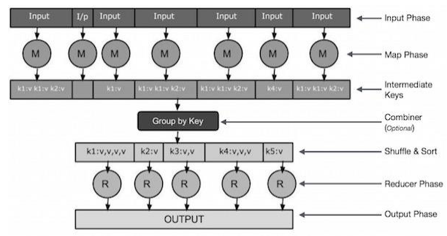
Let us now take a close look at each of the phases and try to understand their significance.

Slide 9
Input Phase − Here we have a Record Reader that translates each record in an input file and sends the parsed data to the mapper in the form of key-value pairs.
Map − Map is a user-defined function, which takes a series of key-value pairs and processes each one of them to generate zero or more key-value pairs.
Intermediate Keys − The key-value pairs generated by the mapper are known as intermediate keys.
Combiner − A combiner is a type of local Reducer that groups similar data from the map phase into identifiable sets. It takes the intermediate keys from the mapper as input and applies a user-defined code to aggregate the values in a small scope of one mapper. It is not a part of the main MapReduce algorithm; it is optional.

Slide 10
Shuffle and Sort − The Reducer task starts with the Shuffle and Sort step. It downloads the grouped key-value pairs onto the local machine, where the Reducer is running. The individual key-value pairs are sorted by key into a larger data list. The data list groups the equivalent keys together so that their values can be iterated easily in the Reducer task.
Reducer − The Reducer takes the grouped key-value paired data as input and runs a Reducer function on each one of them. Here, the data can be aggregated, filtered, and combined in a number of ways, and it requires a wide range of processing. Once the execution is over, it gives zero or more keyvalue pairs to the final step.
Output Phase − In the output phase, we have an output formatter that translates the final key-value pairs from the Reducer function and writes them onto a file using a record writer.

Slide 11
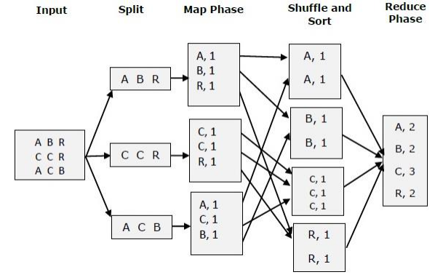
Let us try to understand the two tasks Map & Reduce with the help of a small diagram

Slide 12
MapReduce - Example
Let us take a real-world example to comprehend the power of MapReduce.
Twitter receives around 500 million tweets per day, which is nearly 3000 tweets per second.
The following illustration shows how Tweeter manages its tweets with the help of MapReduce.

Slide 13
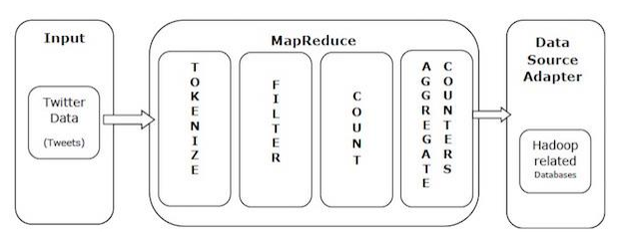
As shown in the illustration, the MapReduce algorithm performs the following actions

Slide 14
Tokenize − Tokenizes the tweets into maps of tokens and writes them as keyvalue pairs.
Filter − Filters unwanted words from the maps of tokens and writes the filtered maps as key-value pairs.
Count − Generates a token counter per word.
Aggregate Counters − Prepares an aggregate of similar counter values into small manageable units.

Slide 15
Mapper Phase
Mapper task is the first phase of processing that processes each input record (from RecordReader) and generates an intermediate key-value pair.
Hadoop Mapper stores intermediate-output on the local disk.

Slide 16
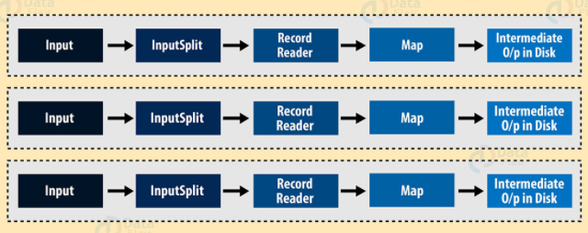
Mapper in Hadoop MapReduce

Slide 17
What is Hadoop Mapper?
Hadoop Mapper task processes each input record and it generates a new <key, value> pairs.
The <key, value> pairs can be completely different from the input pair.
In mapper task, the output is the full collection of all these <key, value> pairs.
Before writing the output for each mapper task, partitioning of output take place on the basis of the key and then sorting is done.

Slide 18
This partitioning specifies that all the values for each key are grouped together.
MapReduce frame generates one map task for each InputSplit generated by the InputFormat for the job.
Mapper only understands <key, value> pairs of data, so before passing data to the mapper, data should be first converted into <key, value> pairs.

Slide 19
How is Key value pair generated in Hadoop?
InputSplit – It is the logical representation of data. It describes a unit of work that contains a single map task in a MapReduce program.
RecordReader – It communicates with the InputSplit and it converts the data into key-value pairs suitable for reading by the Mapper. By default, it uses TextInputFormat for converting data into the key-value pair. RecordReader communicates with the Inputsplit until the file reading is not completed.

Slide 20
How does Hadoop Mapper work?
InputSplits converts the physical representation of the block into logical for the Hadoop mapper. To read the 100MB file, two InputSplits are required. One InputSplit is created for each block and one RecordReader and one mapper are created for each InputSplit.
InputSpits do not always depend on the number of blocks, we can customize the number of splits for a particular file by setting mapred.max.split.size property during job execution.
RecordReader’s responsibility is to keep reading/converting data into key-value pairs until the end of the file. Byte offset (unique number) is assigned to each line present in the file by RecordReader.
Further, this key-value pair is sent to the mapper. The output of the mapper program is called as intermediate data (key-value pairs which are understandable to reduce).

Slide 21
How many map tasks are in Hadoop?
The total number of blocks of the input files handles the number of map tasks in a program.
For maps, the right level of parallelism is around 10-100 maps/node, although for CPU-light map tasks it has been set up to 300 maps.
Since task setup takes some time, so it’s better if the maps take at least a minute to execute.

Slide 22
For example, if we have a block size of 128 MB and we expect 10TB of input data, we will have 82,000 maps. Thus, the InputFormat determines the number of maps.
Hence, No. of Mapper= {(total data size)/ (input split size)}
For example, if data size is 1 TB and InputSplit size is 100 MB then,
No. of Mapper= (1000*1000)/100= 10,000
CONCLUSION
Mapper takes the set of key-value pair generates by InputSplit and RecordReader and generates intermediate key-value pairs.

Slide 23
Reducer Phase
In Hadoop, Reducer takes the output of the Mapper (intermediate key-value pair) process each of them to generate the output.
The output of the reducer is the final output, which is stored in HDFS.
Usually, in the Hadoop Reducer, we do aggregation or summation sort of computation

Slide 24
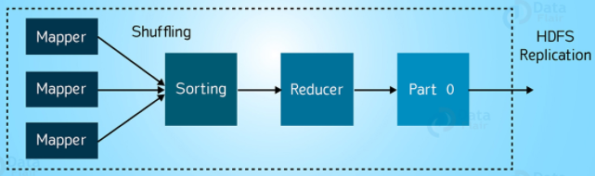
Hadoop Reducer

Slide 25
What is Hadoop Reducer?
The Reducer processes the output of the mapper.
After processing the data, it produces a new set of output. At last HDFS stores this output data.
Hadoop Reducer takes a set of an intermediate key-value pair produced by the mapper as the input and runs a Reducer function on each of them.
One can aggregate, filter, and combine this data (key, value) in a number of ways for a wide range of processing.

Slide 26
Reducer first processes the intermediate values for particular key generated by the map function and then generates the output (zero or more key-value pair).
One-one mapping takes place between keys and reducers.
Reducers run in parallel since they are independent of one another.
The user decides the number of reducers.
By default number of reducers is 1.

Slide 27
Phases of MapReduce Reducer
There are 3 phases of Reducer in Hadoop MapReduce.
1. Shuffle Phase of MapReduce Reducer
In this phase, the sorted output from the mapper is the input to the Reducer.
In Shuffle phase, with the help of HTTP, the framework fetches the relevant partition of the output of all the mappers.

Slide 28
2. Sort Phase of MapReduce Reducer
In this phase, the input from different mappers is again sorted based on the similar keys in different Mappers.
The shuffle and sort phases occur concurrently.
3. Reduce Phase
In this phase, after shuffling and sorting, reduce task aggregates the key-value pairs.
The OutputCollector.collect() method, writes the output of the reduce task to the Filesystem. Reducer output is not sorted.

Slide 29
MapReduce Number of Reducers
With the help of Job.setNumreduceTasks(int) the user set the number of reducers for the job.
The right number of reducers are 0.95 or 1.75 multiplied by (<no. of nodes> * <no. of the maximum container per node>).
With 0.95, all reducers immediately launch and start transferring map outputs as the maps finish.
With 1.75, the first round of reducers is finished by the faster nodes and second wave of reducers is launched doing a much better job of load balancing.

Slide 30
Increasing the number of Reducers
Increases the Framework overhead.
Increases load balancing.
Lowers the cost of failures.

Slide 31
CONCLUSION
Hadoop Reducer is the second phase of processing in MapReduce.
Hadoop Reducer does aggregation or summation sort of computation by three phases(shuffle, sort and reduce).
Thus, HDFS Stores the final output of Reducer.

Slide 32
PARTITIONER
The Partitioner in MapReduce controls the partitioning of the key of the intermediate mapper output.
By hash function, key (or a subset of the key) is used to derive the partition.
A total number of partitions depends on the number of reduce task.

Slide 33
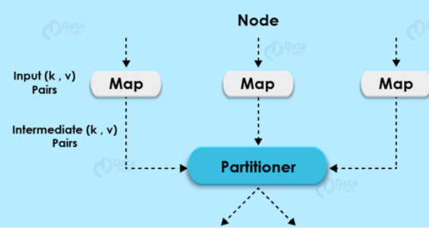
Partitioner in Hadoop MapReduce

Slide 34
What is Hadoop Partitioner?
Partitioning of the keys of the intermediate map output is controlled by the Partitioner.
By hash function, key (or a subset of the key) is used to derive the partition.
According to the key-value each mapper output is partitioned and records having the same key value go into the same partition (within each mapper), and then each partition is sent to a reducer.
Partition class determines which partition a given (key, value) pair will go.
Partition phase takes place after map phase and before reduce phase.

Slide 35
Need of Hadoop MapReduce Partitioner?
MapReduce job takes an input data set and produces the list of the key-value pair which is the result of map phase in which input data is split and each task processes the split and each map, output the list of key-value pairs.
Then, the output from the map phase is sent to reduce task which processes the user-defined reduce function on map outputs.
But before reduce phase, partitioning of the map output take place on the basis of the key and sorted.

Slide 36
This partitioning specifies that all the values for each key are grouped together and make sure that all the values of a single key go to the same reducer, thus allows even distribution of the map output over the reducer.
Partitioner in Hadoop MapReduce redirects the mapper output to the reducer by determining which reducer is responsible for the particular key.
The Default Hadoop partitioner in Hadoop MapReduce is Hash Partitioner which computes a hash value for the key and assigns the partition based on this result.

Slide 37
Poor Partitioning in Hadoop MapReduce
If in data input one key appears more than any other key. In such case, we use two mechanisms to send data to partitions.
The key appearing more will be sent to one partition.
All the other key will be sent to partitions according to their hashCode().
But if hashCode() method does not uniformly distribute other keys data over partition range, then data will not be evenly sent to reducers.

Slide 38
Poor partitioning of data means that some reducers will have more data input than other i.e. they will have more work to do than other reducers. So, the entire job will wait for one reducer to finish its extra-large share of the load.
To overcome poor partitioner in Hadoop MapReduce, we can create Custom partitioner, which allows sharing workload uniformly across different reducers.
CONCLUSION
Hadoop Partitioner allows even distribution of the map output over the reducer. In Partitioner, partitioning of map output take place on the basis of the key and sorted.

Slide 39
COMBINER
Hadoop Combiner is also known as “Mini-Reducer” that summarizes the Mapper output record with the same Key before passing to the Reducer.
A Combiner, also known as a semi-reducer, is an optional class that operates by accepting the inputs from the Map class and thereafter passing the output key-value pairs to the Reducer class.
The main function of a Combiner is to summarize the map output records with the same key. The output (key-value collection) of the combiner will be sent over the network to the actual Reducer task as input.

Slide 40
What is Hadoop Combiner?
On a large dataset when we run MapReduce job, large chunks of intermediate data is generated by the Mapper and this intermediate data is passed on the Reducer for further processing, which leads to enormous network congestion.
MapReduce framework provides a function known as Hadoop Combiner that plays a key role in reducing network congestion.The combiner in MapReduce is also known as ‘Mini-reducer’.
The primary job of Combiner is to process the output data from the Mapper, before passing it to Reducer.
It runs after the mapper and before the Reducer and its use is optional.

Slide 41
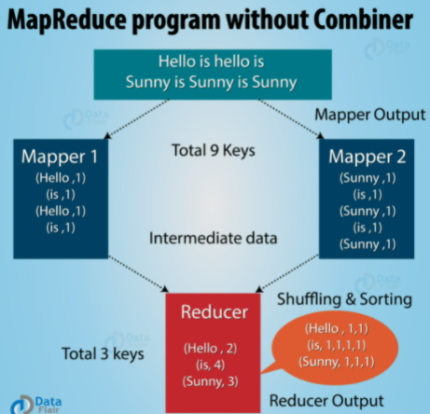
How does MapReduce without Combiner work?

Slide 42
In the above diagram, no combiner is used. Input is split into two mappers and 9 keys are generated from the mappers.
Now we have (9 key/value) intermediate data, the further mapper will send directly this data to reducer and while sending data to the reducer, it consumes some network bandwidth (bandwidth means time taken to transfer data between 2 machines).
It will take more time to transfer data to reducer if the size of data is big.

Slide 43
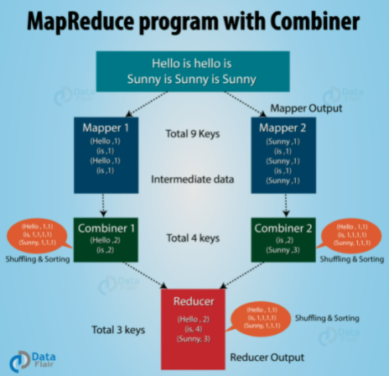
How does MapReduce with Combiner work?

Slide 44
Now in between mapper and reducer we use a hadoop combiner, then combiner shuffles intermediate data (9 key/value) before sending it to the reducer and generates 4 key/value pair as an output.
Reducer now needs to process only 4 key/value pair data which is generated from 2 combiners.
Thus reducer gets executed only 4 times to produce final output, which increases the overall performance.

Slide 45
Advantages of MapReduce Combiner
Hadoop Combiner reduces the time taken for data transfer between mapper and reducer.
It decreases the amount of data that needed to be processed by the reducer.
The Combiner improves the overall performance of the reducer.

Slide 46
Disadvantages of MapReduce Combiner
MapReduce jobs cannot depend on the Hadoop combiner execution because there is no guarantee in its execution.
In the local filesystem, the key-value pairs are stored in the Hadoop and run the combiner later which will cause expensive disk IO.

Slide 47
CONCLUSION
MapReduce Combiner plays a key role in reducing network congestion.
MapReduce combiner improves the overall performance of the reducer by summarizing the output of Mapper.

